Slide 1
Member Billing Assembly Accounting for Faithful Comptrollers
Session 2

Slide 2
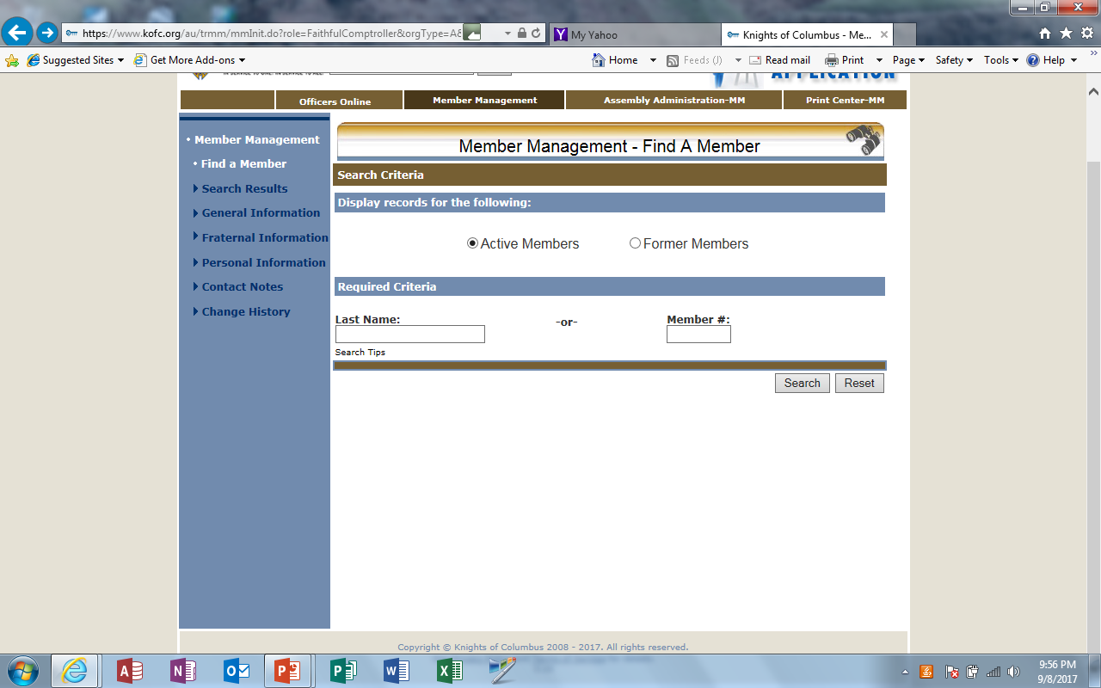
We will now go to Member Billing. Click on “Officers Online”

Slide 3
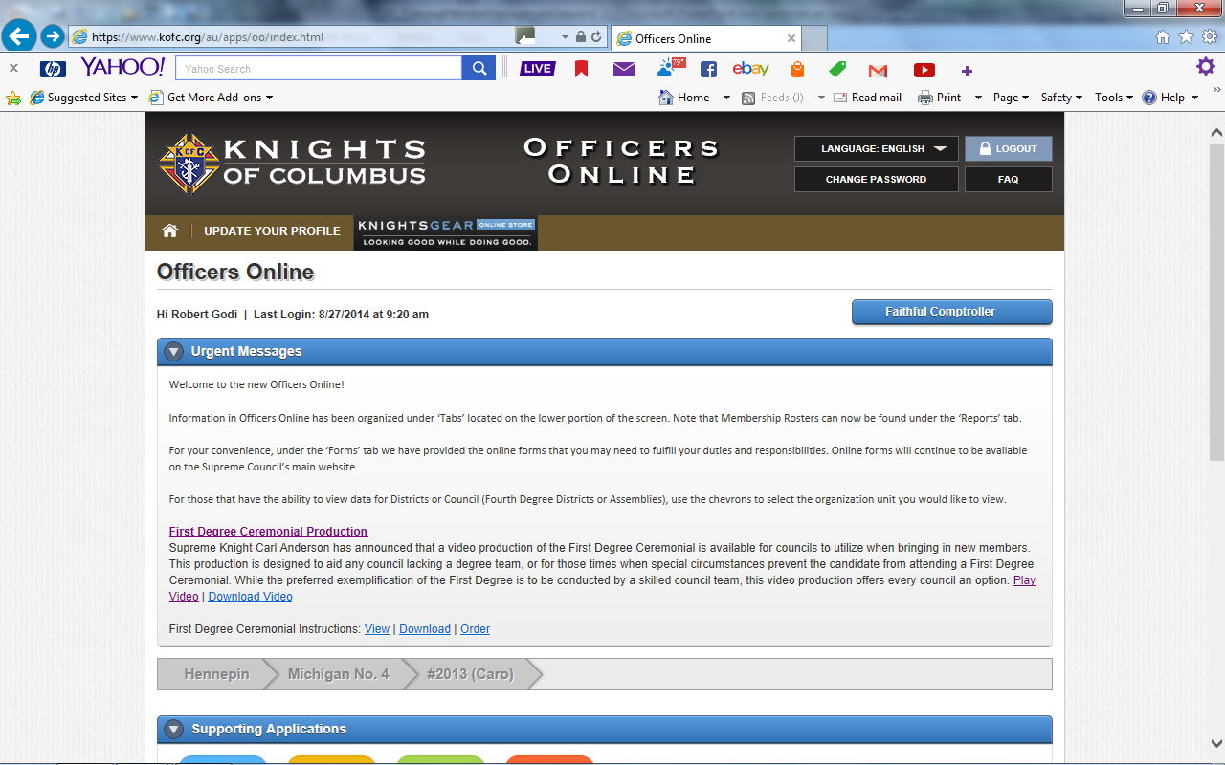

Slide 4
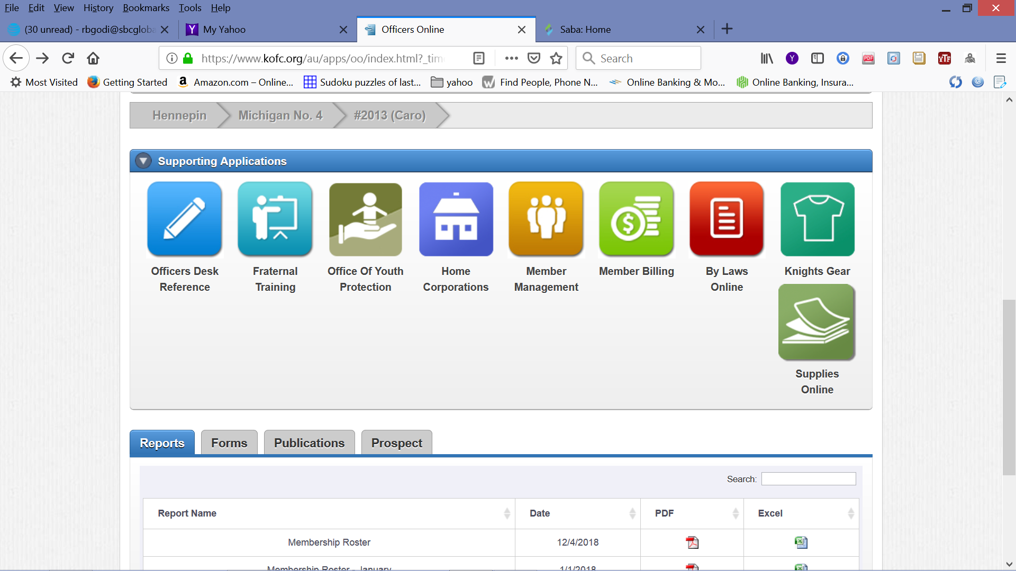
We will now continue to Member Billing by clicking on Member Billing tab

Slide 5
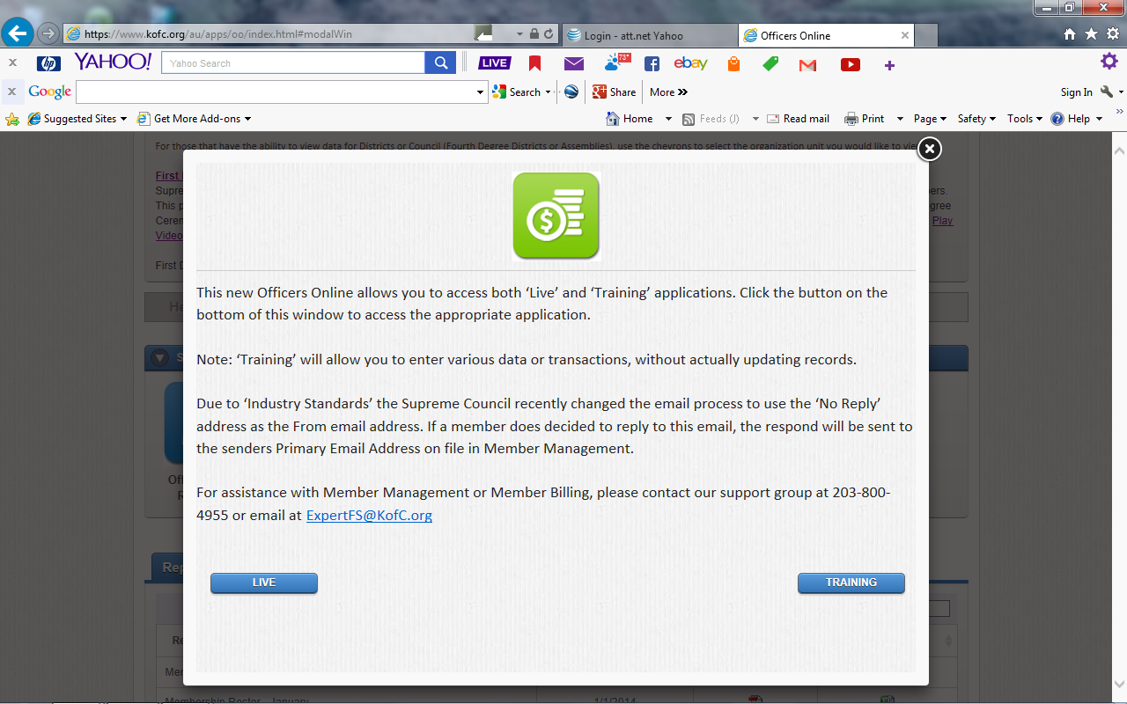

Slide 6
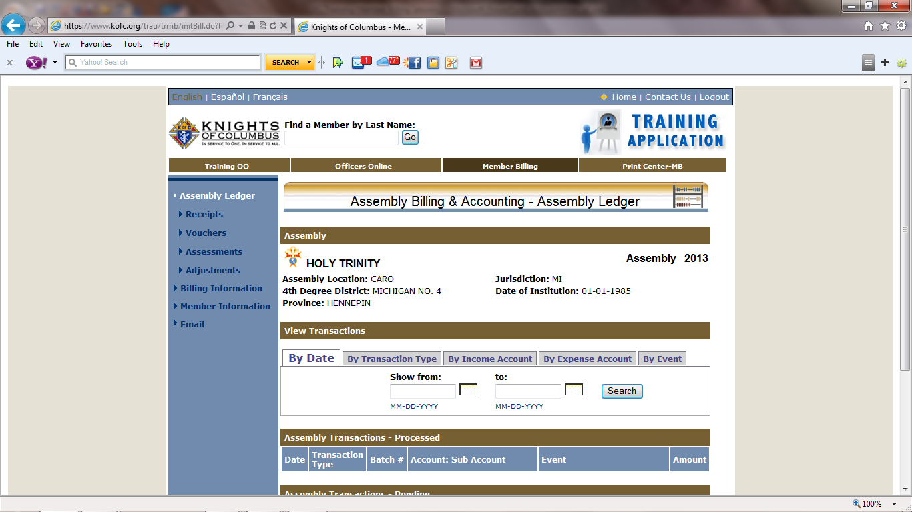
Note: We are now in the Training Application. We will be using the “TRAINING DATA BASE” and any changes made to this data base DOES NOT effect your Live Assembly Data this training data base will be update monthly based on your actual council data.
NOTE: Any changes that you want to save in your Live Assembly Data Base will need to done from Member Management at Supreme
Your assembly information is in this area.
We will start by working with Billing Information so Click on Billing Information Link.

Slide 7
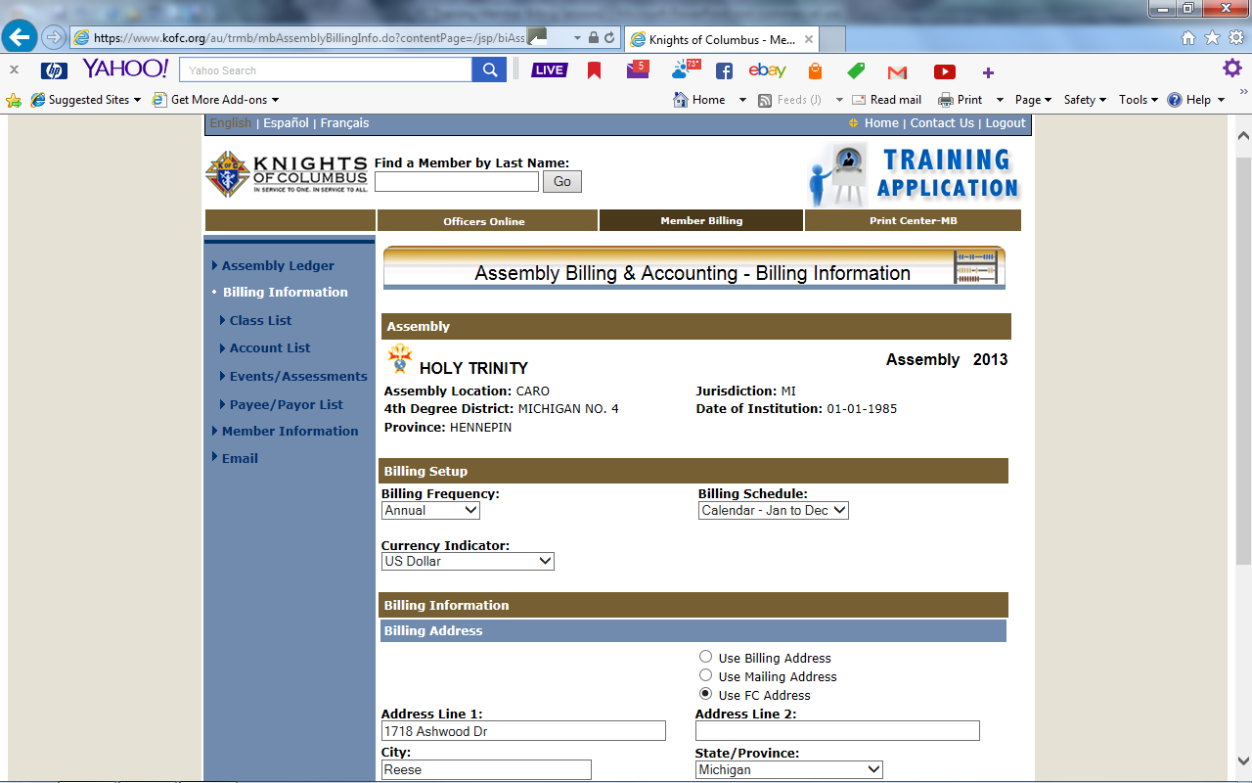
Or Semi Annual
Fraternal – Jul to Jun

Slide 8
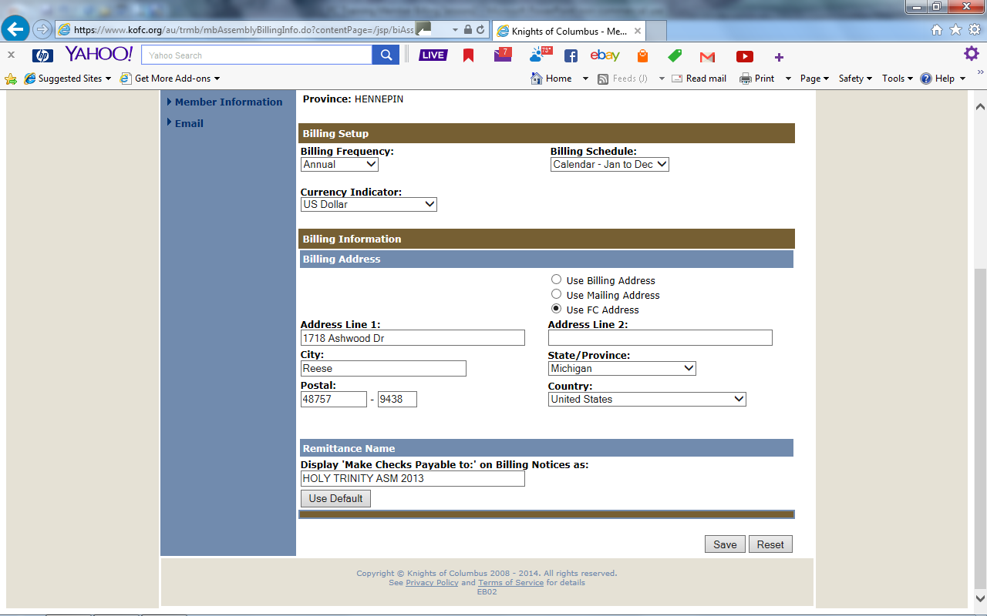
You can choose “Use FC Address” and have payments sent to FC’s home.

Slide 9
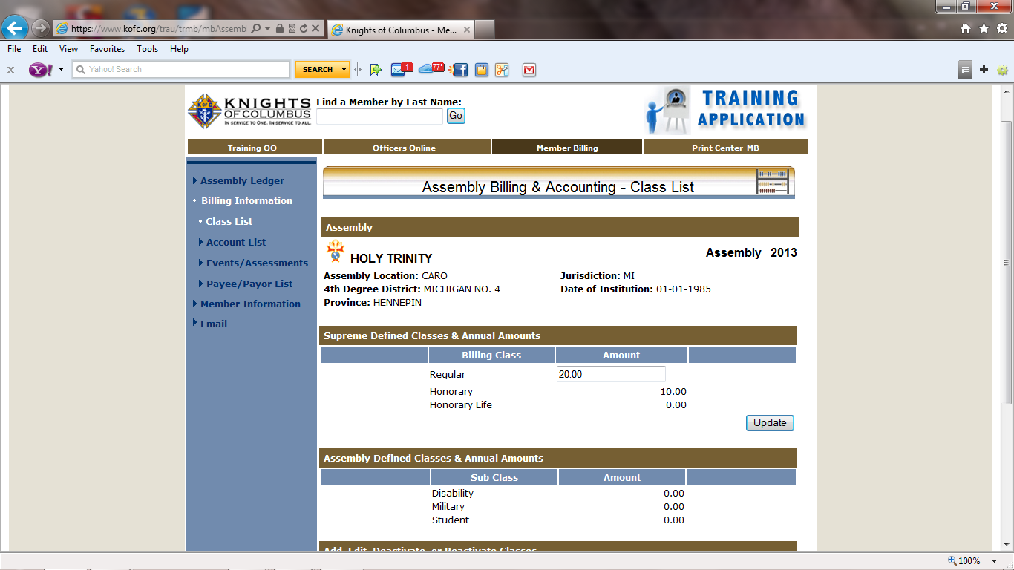
We have previously add all Data when we were working in Member Management.
We will now work with the accounts list. Click on Link
You will need to fill in these amounts then click update
You can add, edit, deactivate or reactivate class.

Slide 10
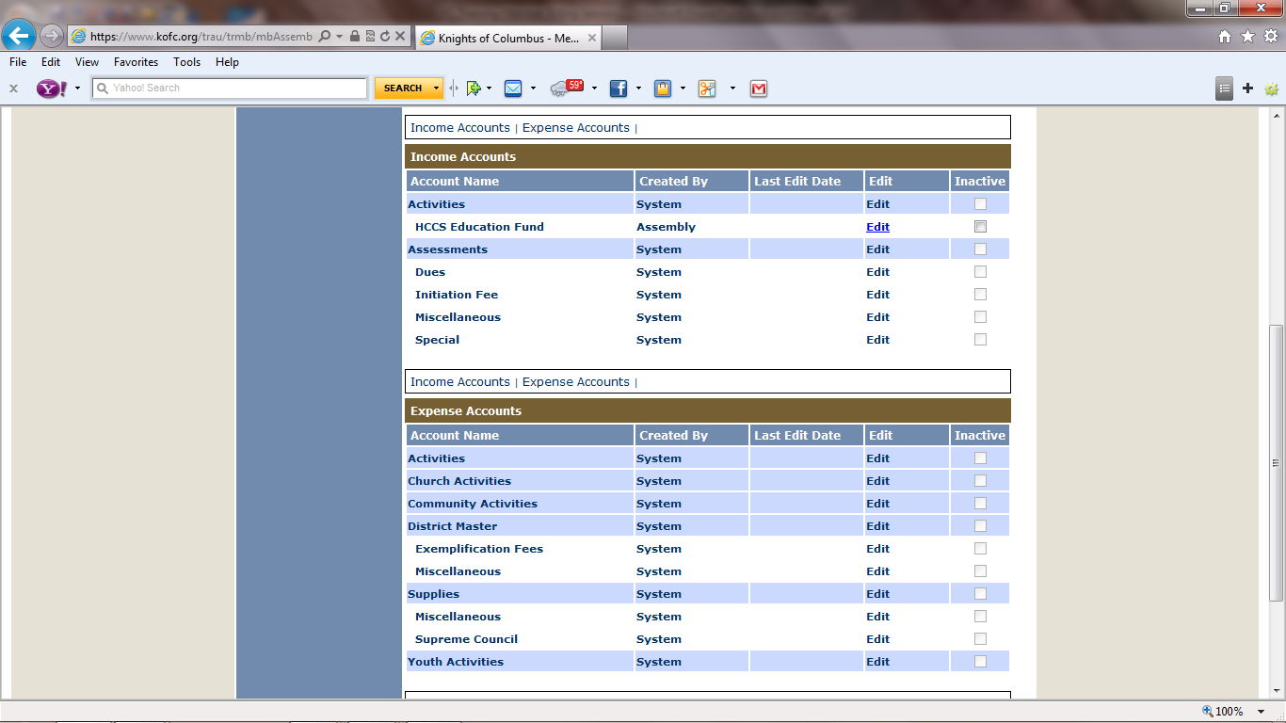
Income Account
The Local Assemblies can add their own defined Income & Expense Accounts.
Expense Account

Slide 11
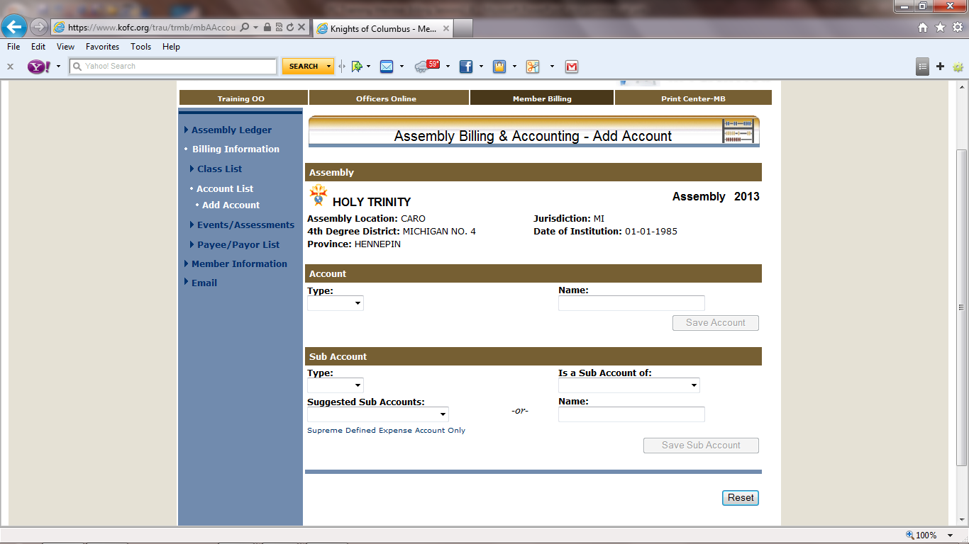
We will now click the “Add Account Link.”

Slide 12
We will begin by adding a new income account

Slide 13
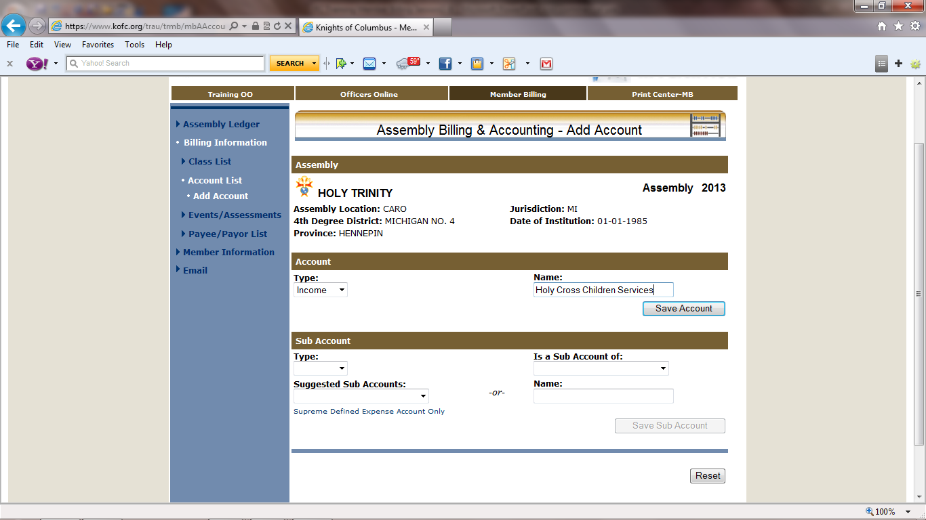
We will now create an income account by clicking on the down arrow in the Type box. It will give us a drop down box, menu of income or expense then highlight income.
Holy Cross Services
We have entered a new income account with the name of: Holy Cross Services Be sure to save by clicking “Save Account” tab.
If a mistake is made you can reset this page before you save. The screen will refresh with a new blank page.

Slide 14
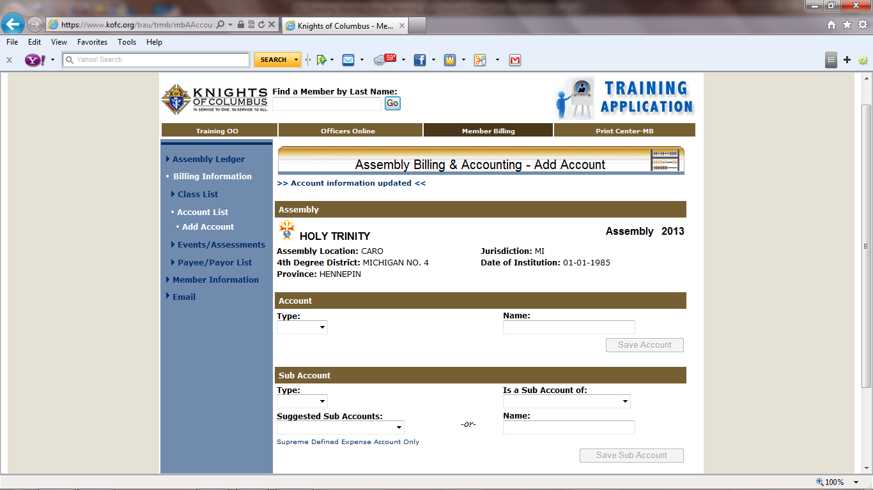
Note confirmation of saved account
We will now work with a Sub Account

Slide 15
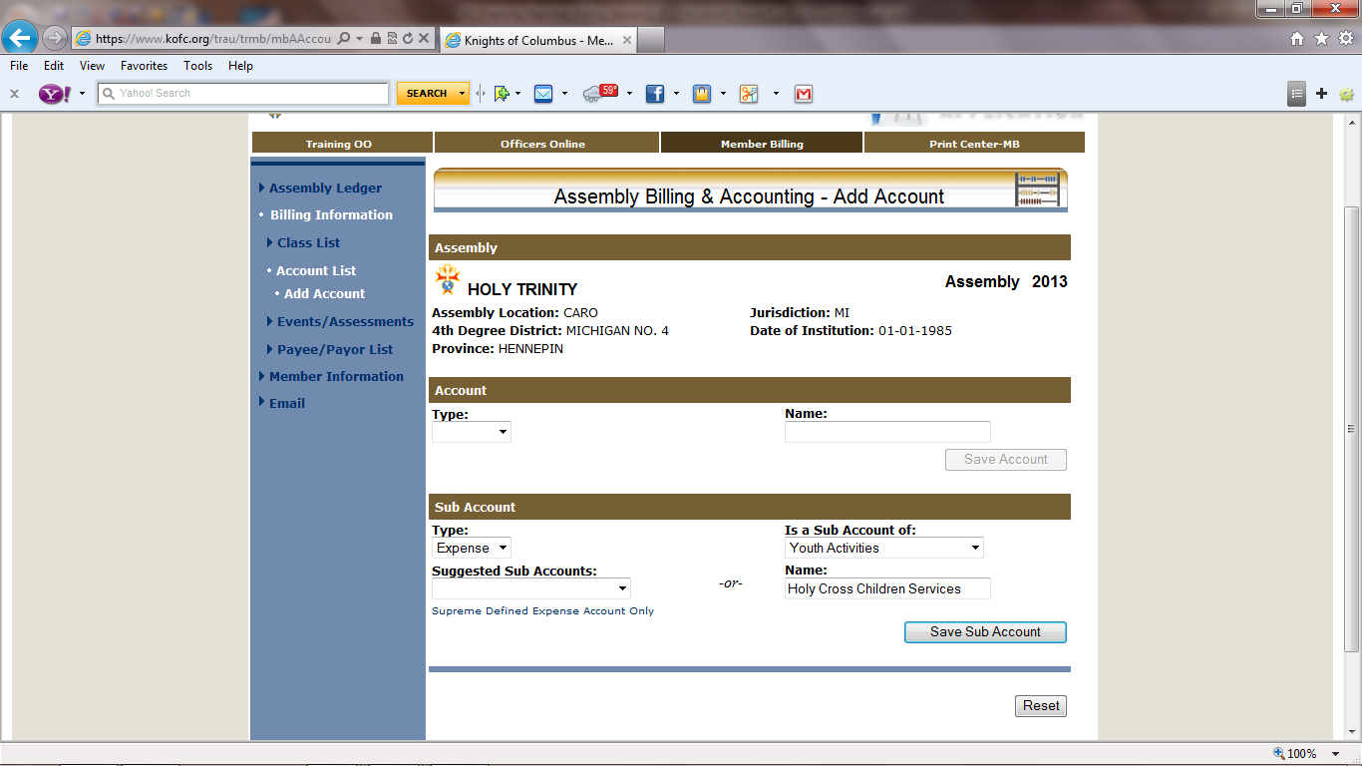
We have entered a new Expense Account it is a Sub Account of Youth Activities with the name of: Holy Cross Children Services. Be sure to save!!
If we discover we have made a mistake or have changed our mind, can use the reset button before we save. We will be given a new screen and start over.

Slide 16
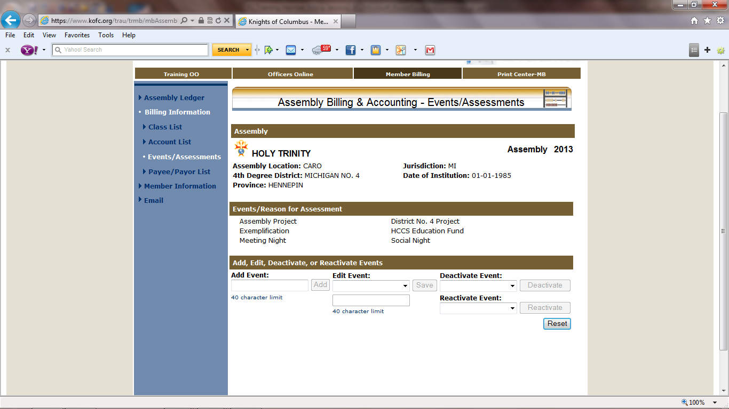
This Area is showing all of our active Events/Reason for Assessments
Now that the screen has refreshed. We will work on Events/Assessments. By clicking on the :Events/Assessments” Link

Slide 17
We will add a new Event by typing in the event name in the Add Event: box. When you type the first letter of the name the “Add” button will activate. Now click the Add button

Slide 18
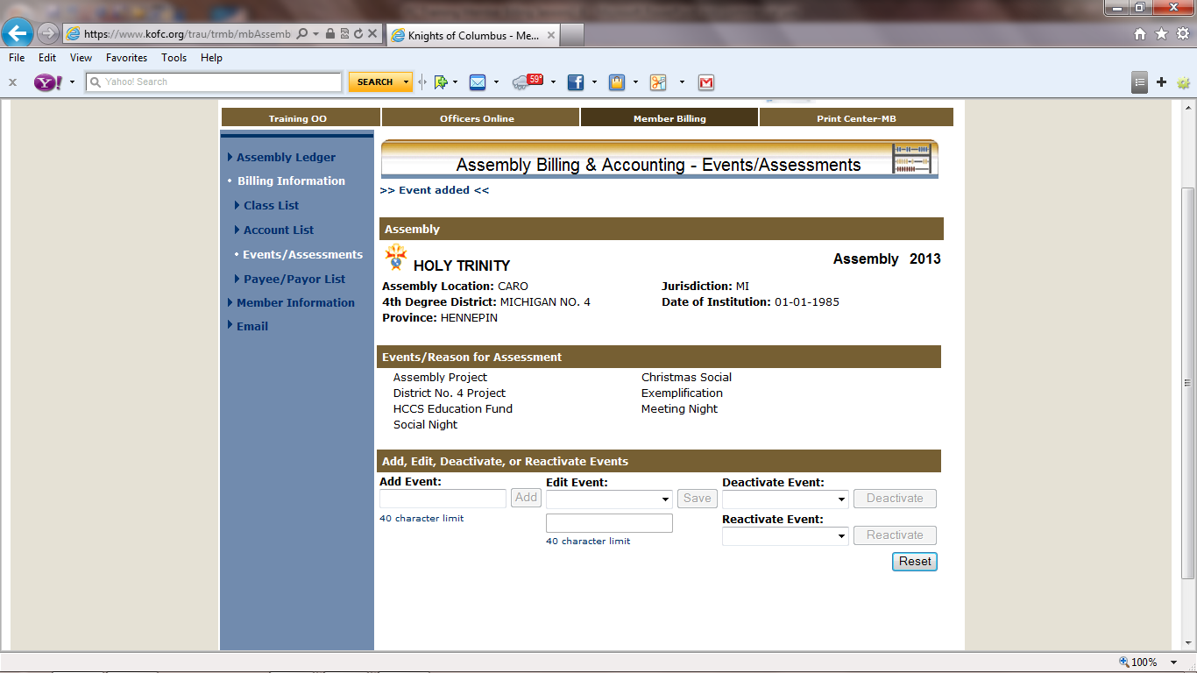
Note confirmation of Event Added

Slide 19
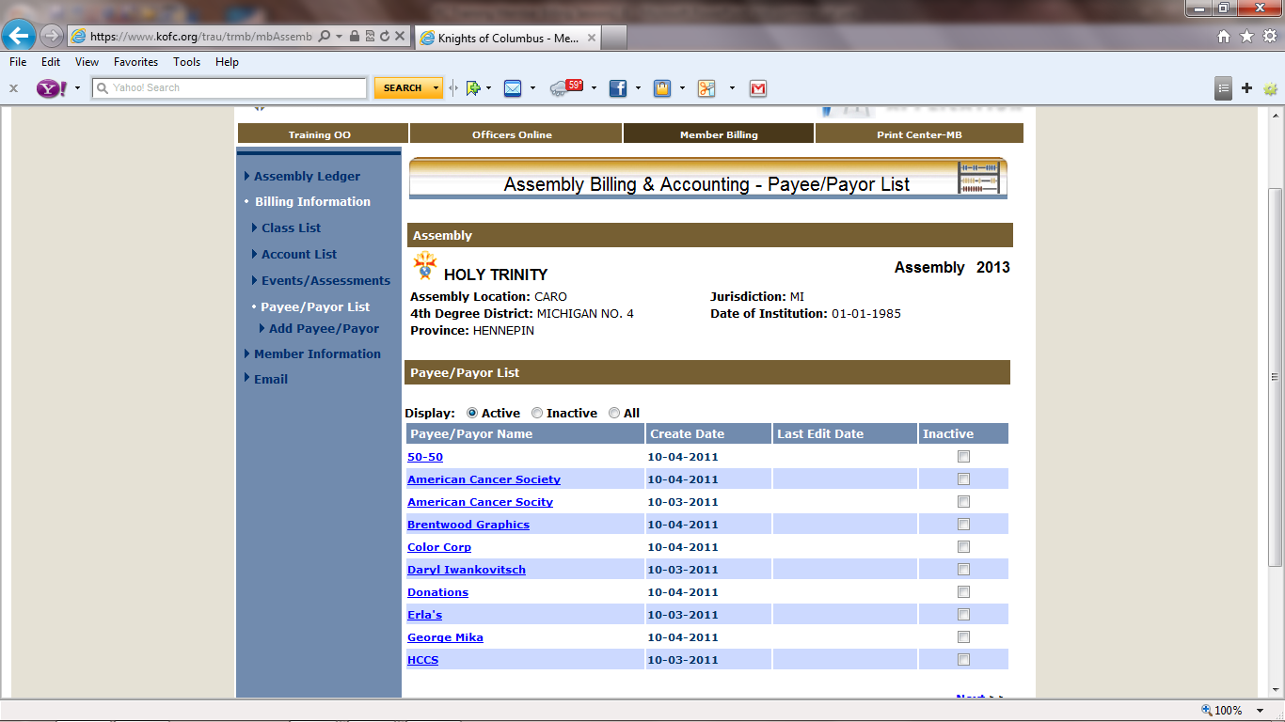
Now we will work on Adding non-member Payee/Payor by clicking on the Payee/Payor List Link.
Payee/Payor List

Slide 20
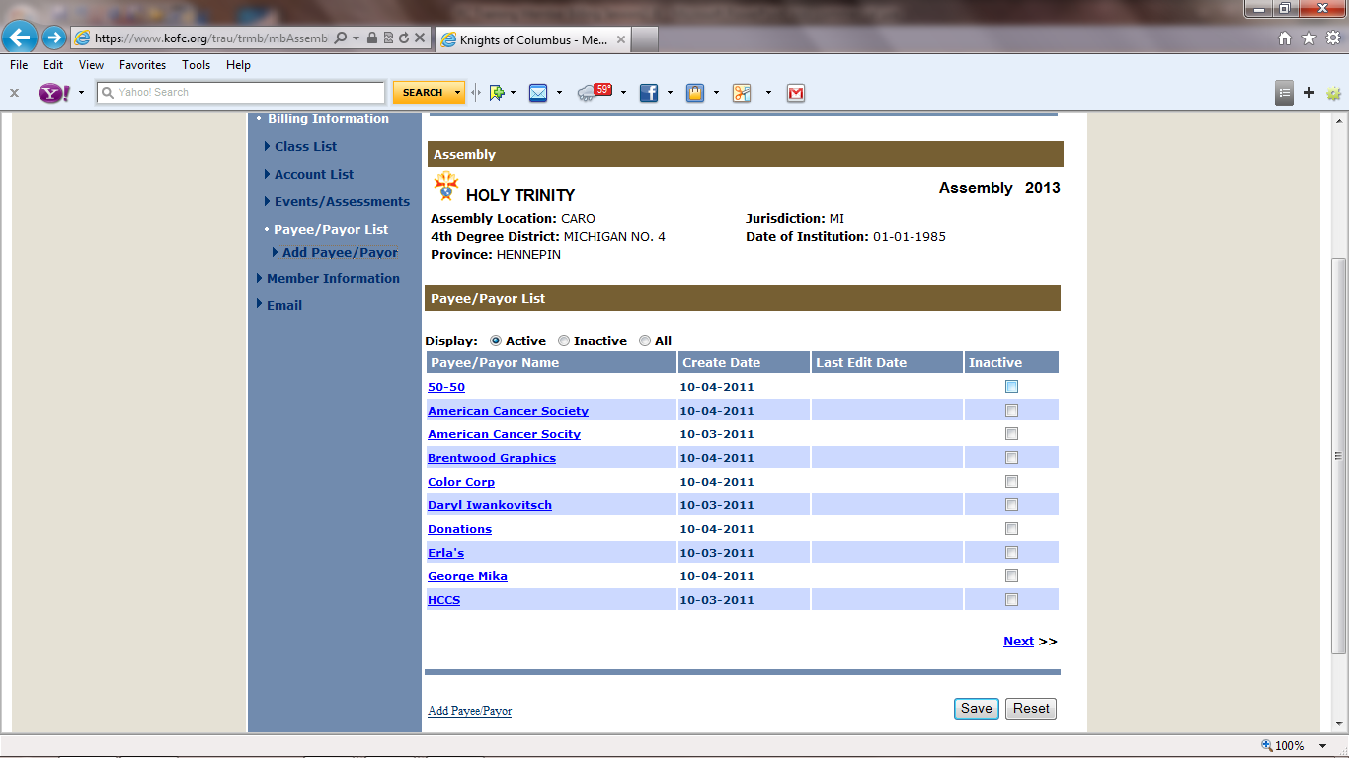
We will now click on one of the “Add Payee/Payor” Link.

Slide 21
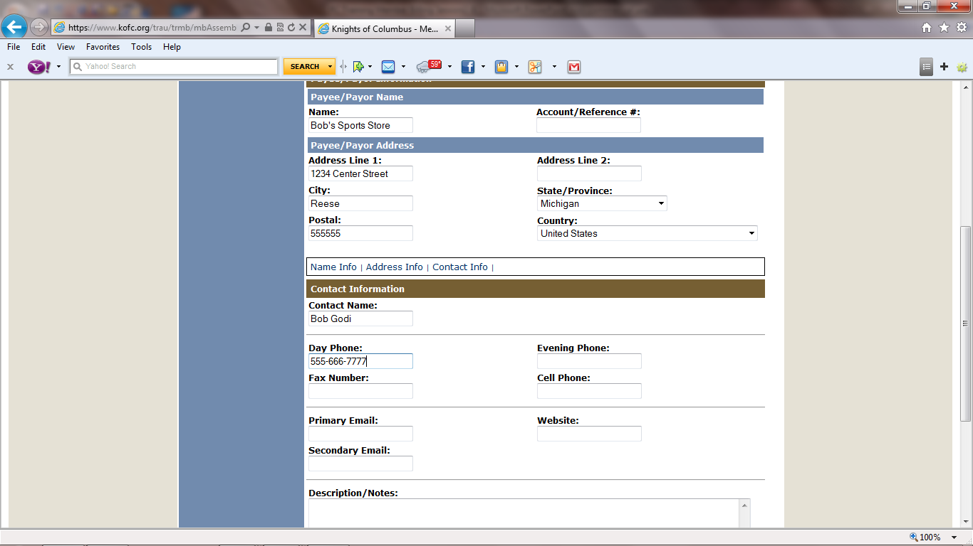
We will type in as much information that we have for this Payee/Payor

Slide 22
Now that we entered the information we have, we will save it. As more information becomes available we will be able to Edit it later.
To edit a Payee/Payor start by clicking on Billing information, then click on Payee/Payor List, then highlight Payee/Payor, make any Changes or Additions then SAVE.
If we discover we have made a mistake or have changed our mind, can use the reset button before we save. We will be given a new screen and start over.

Slide 23
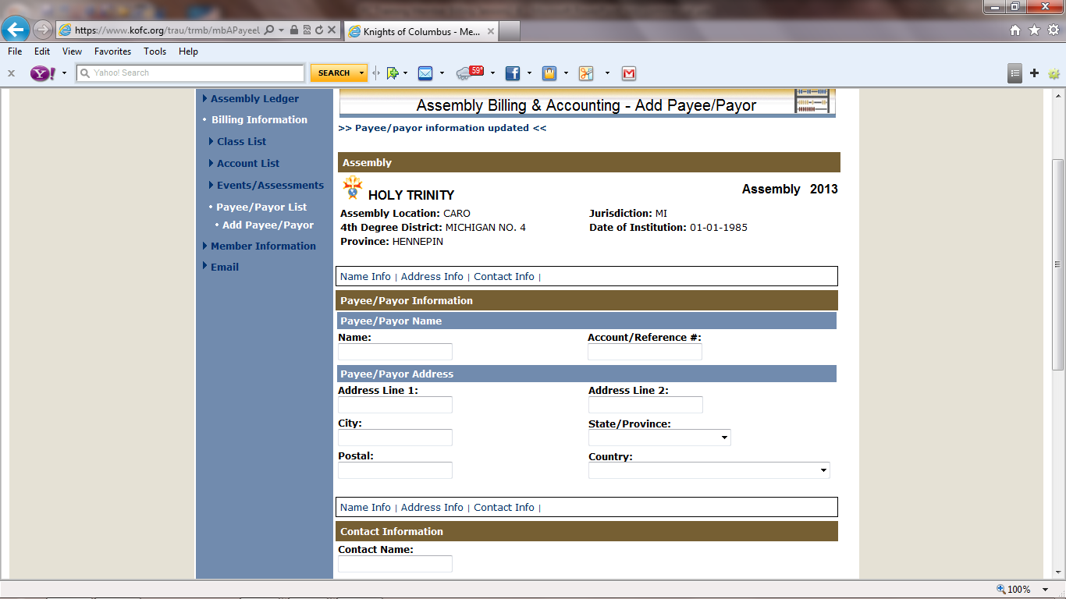
Note: Payee/Payor List Updated
We will now work with Member Information

Slide 24
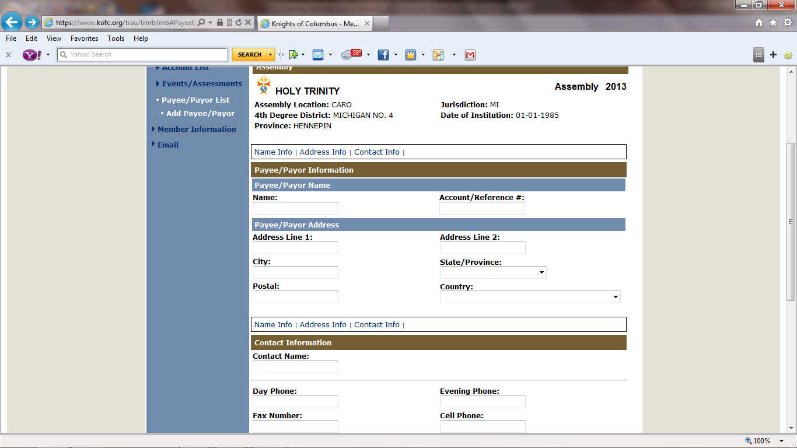
We will now work with Member Information by clicking on the “Member Information” Link.

Slide 25
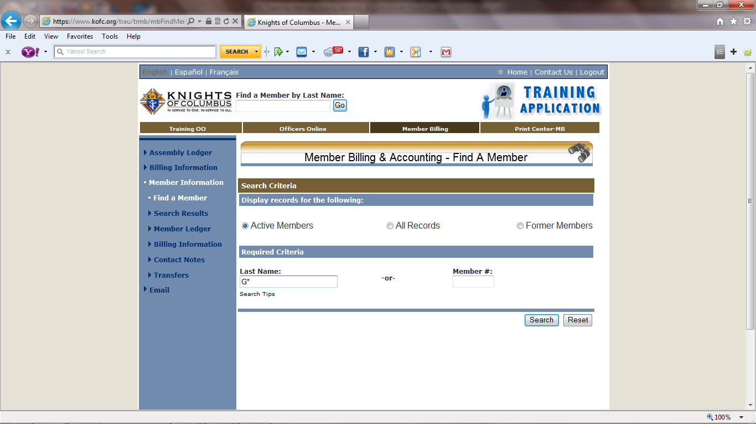
We will now search for a member by typing in the first letter of his last name i.e. G or g. Then click on “search”

Slide 26
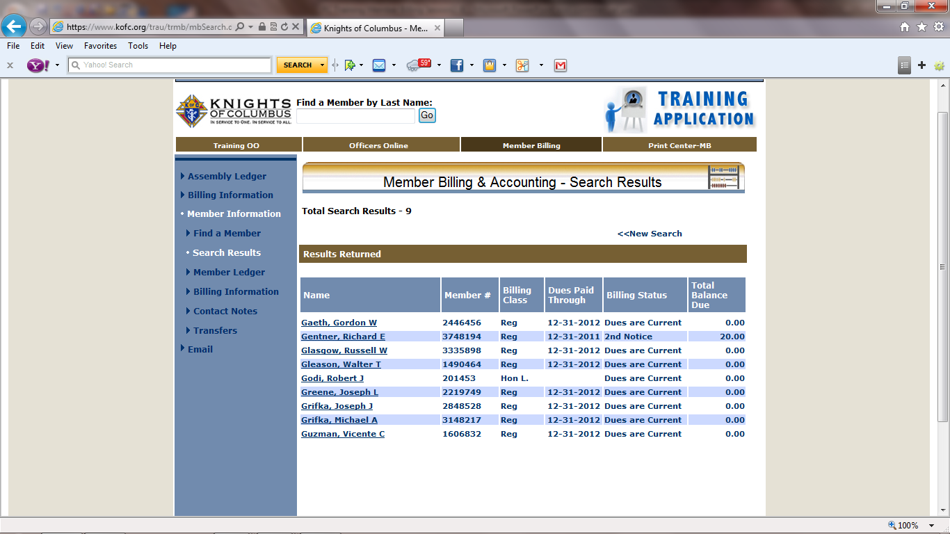
The Search Results have listed all the members whose last name begins with “G”

Slide 27
We will click on Godi, Robert J

Slide 28
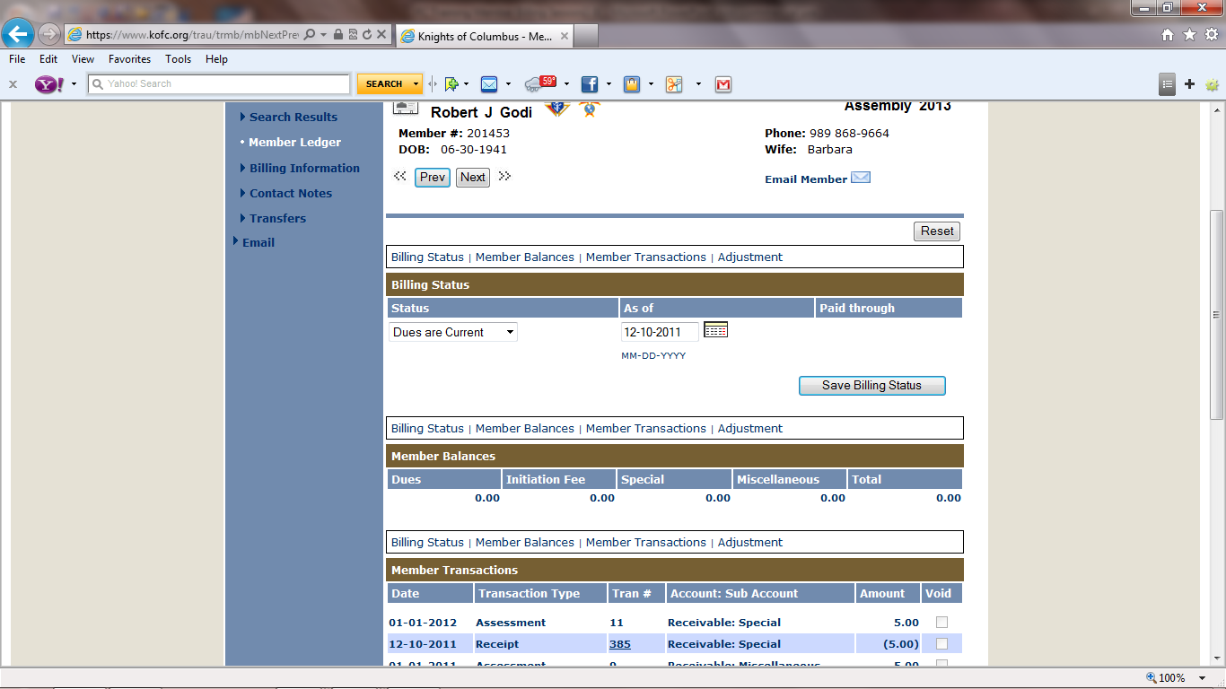
We have opened Sir Knight Godi’s Member Ledger. This slide and the next are all on one page in the Supreme online Member Management program

Slide 29
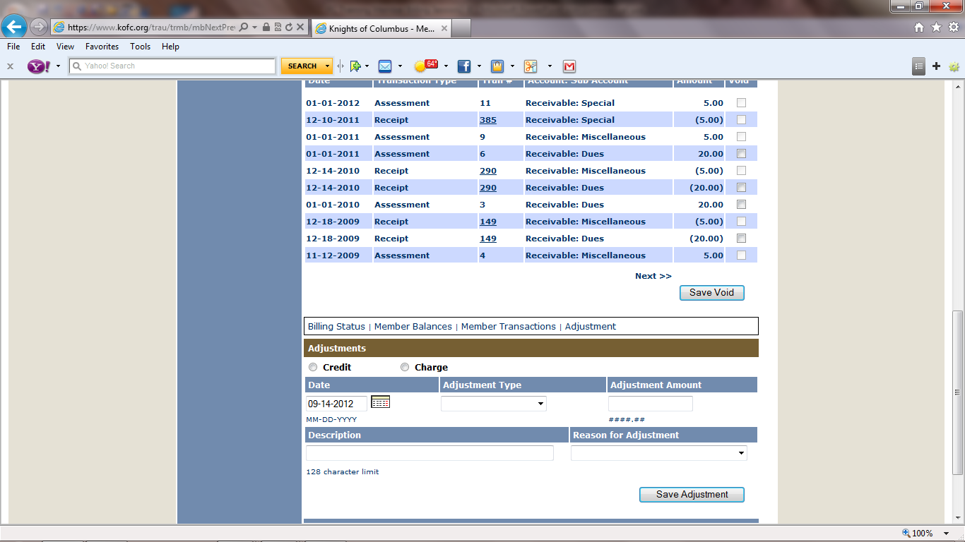
We have opened Sir Knight Godi’s Member Ledger. This slide and the previous are all on one page in the Supreme online Member Management program

Slide 30
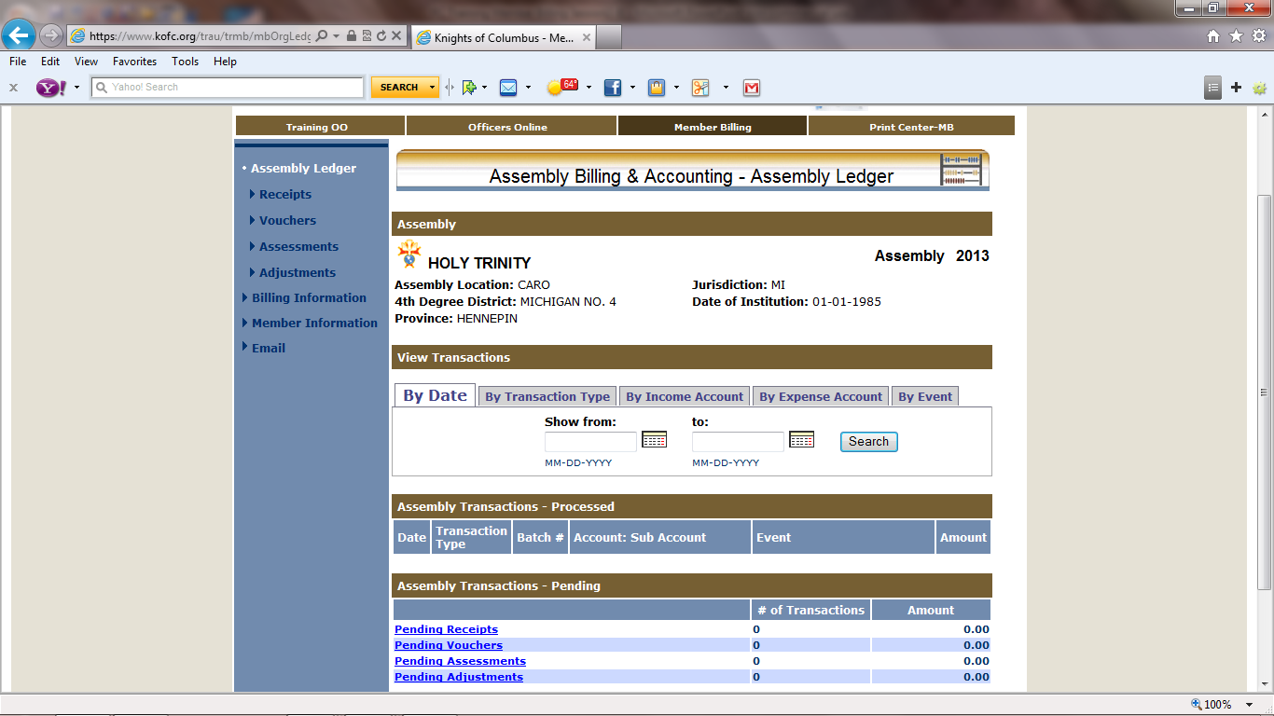
We will begin working with Receipts Click on the “Receipts” Link.

Slide 31
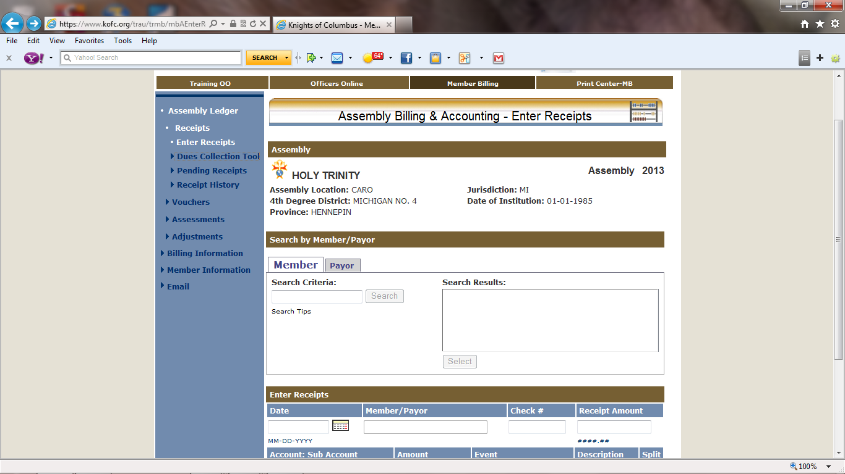
Let’s begin by working with the “Dues Collection Tool” by clicking the Link.

Slide 32
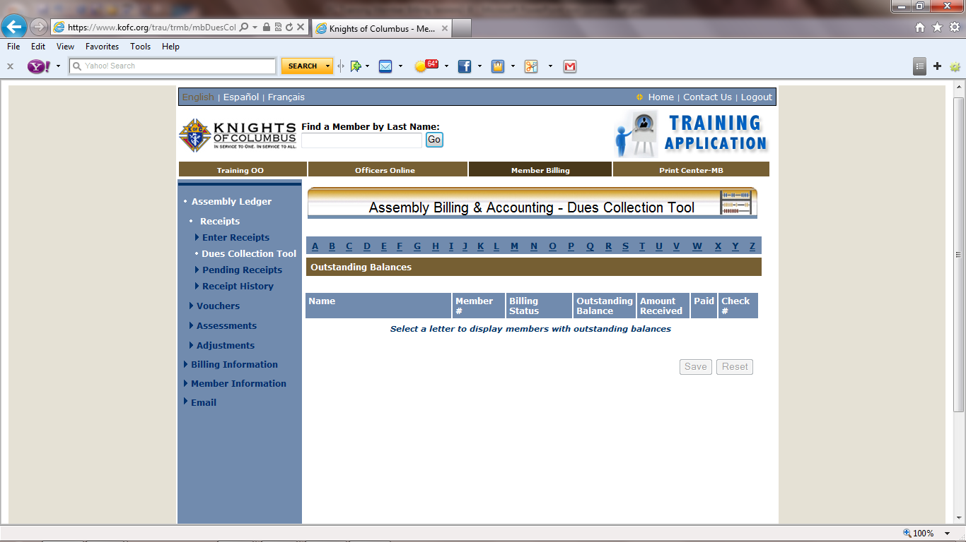
We begin by clicking on the letter that is the letter of the members last name “Avery” to enter his dues payment.

Slide 33
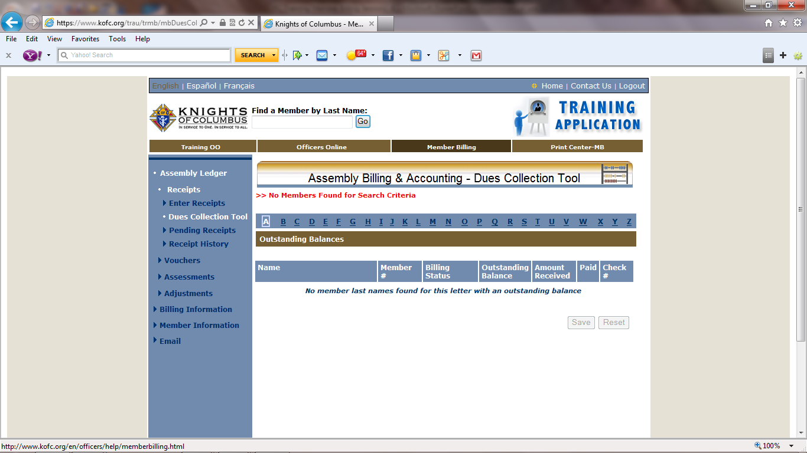
NOTE!
It appears that Sir Knight Avery has already Paid his dues and Assessments.
We have a member whose last name begins with “J” to enter his dues payment..

Slide 34
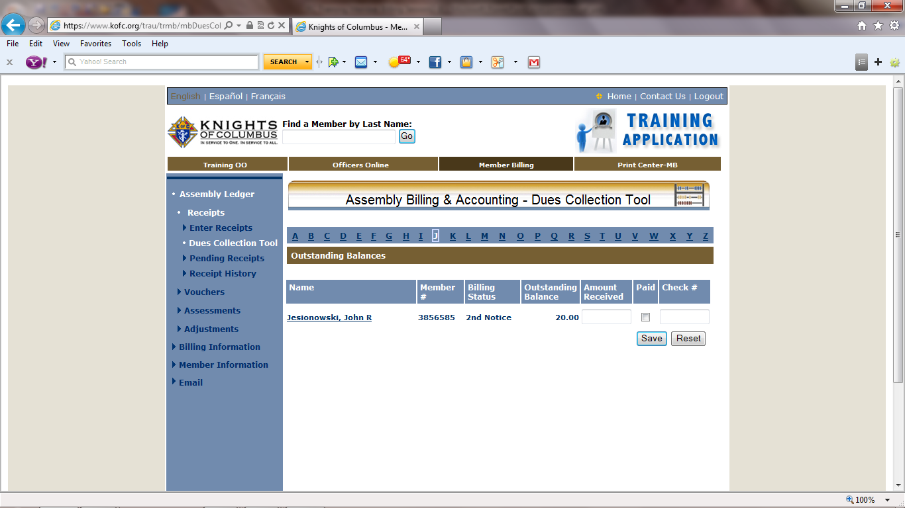
We have one member who has an outstanding balance. He is on 2nd Notice. We will now enter the amount he has paid. If he has paid the full amount check the paid box. The Amount paid will be filled in then fill in the check # with a number or the word cash. If he has paid less than the full amount enter that amount in the “Amount Received” box, a check mark will be add then fill in the “Check #” box or if paid with cash enter cash.

Slide 35
Now that we have entered all the “J”’s. We can now “SAVE”.

Slide 36
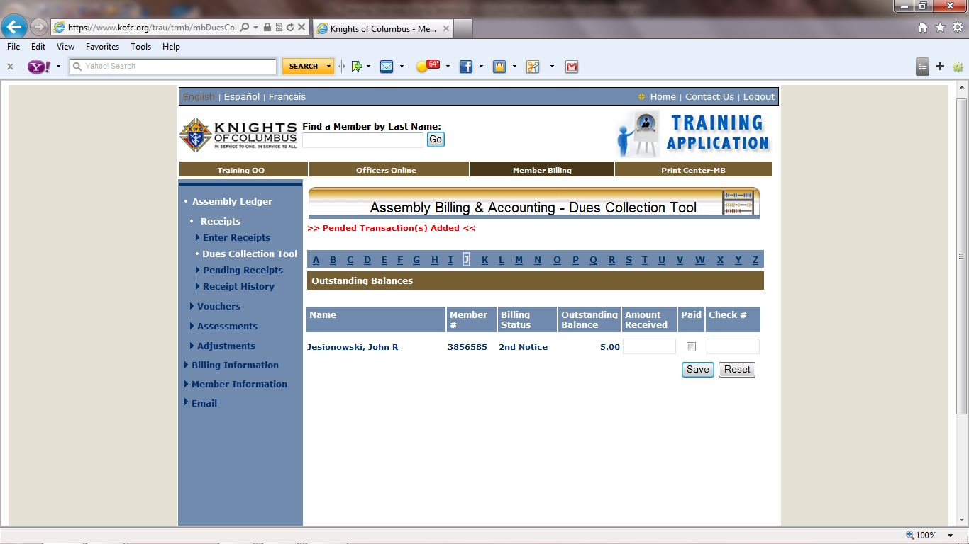
Note: Transactions have been posted to “Pending Receipts
Sir Knight Jesionowski only made a partial payment therefore he still has a balance due.

Slide 37
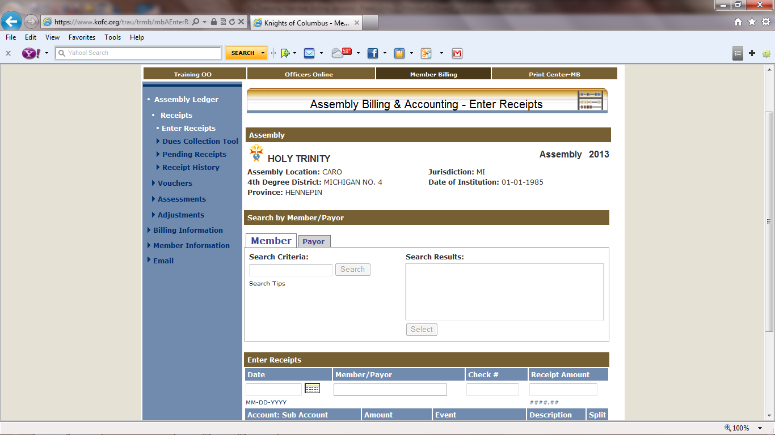
Note: The “Member” tab is Larger than “Payor” tab”
We will now enter monies received from Sir Knight Robert Godi, that are not dues.

Slide 38
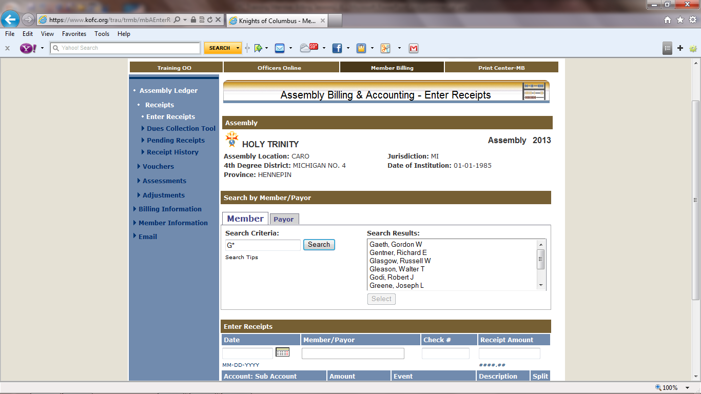
We have received monies from Robert Godi. We filled in the “Search Criteria” with G and clicked on the “Search” tab.

Slide 39
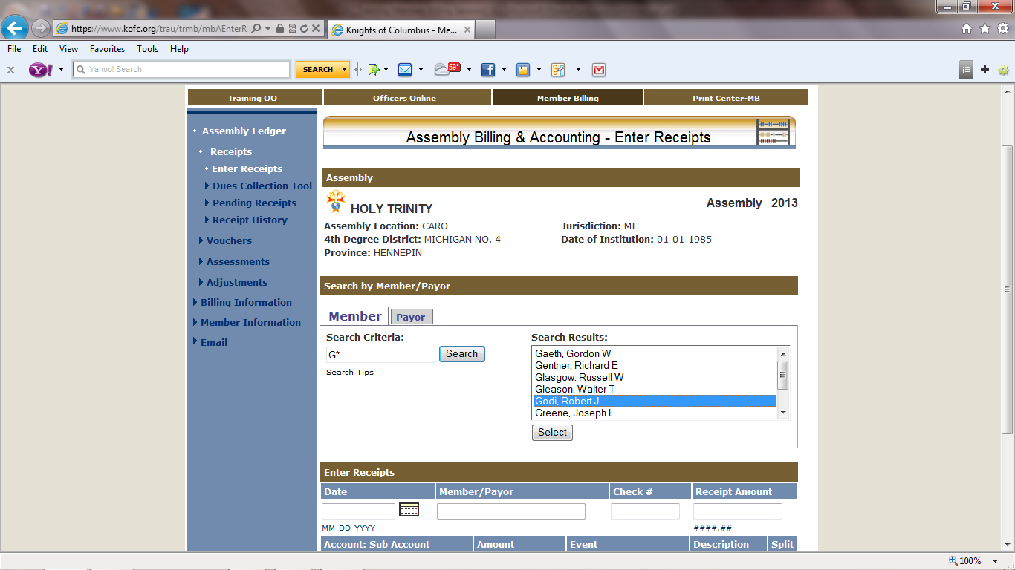
This screen has refreshed with all the members who last name begin with the letter ”G”. We now highlight Sir Knight Godi. The “select” will activate. Then click it.

Slide 40
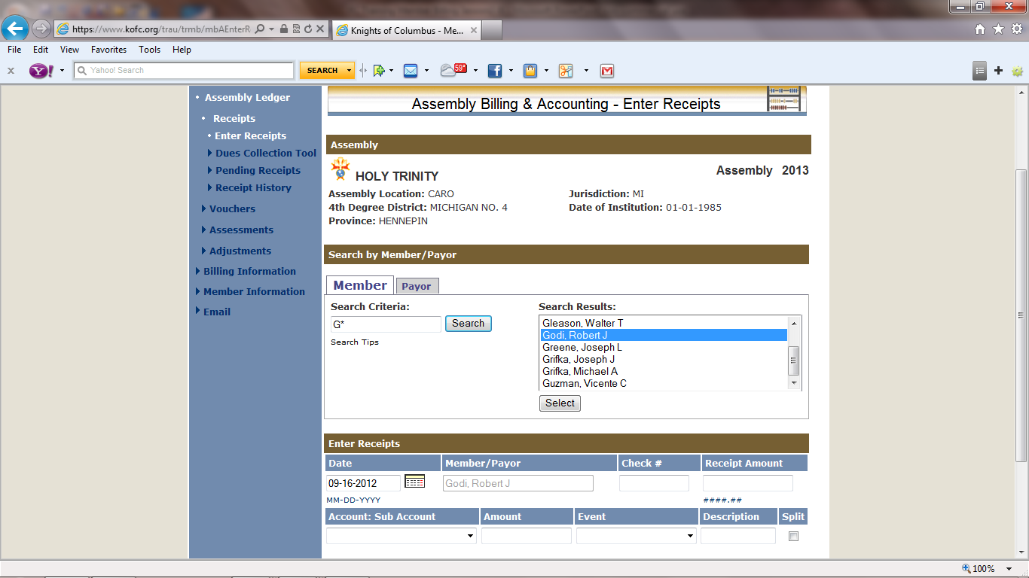
The screen has refreshed. Godi, Robert J. has been added to the “Member/Payor” Box. We will now fill-in remaining detail.

Slide 41
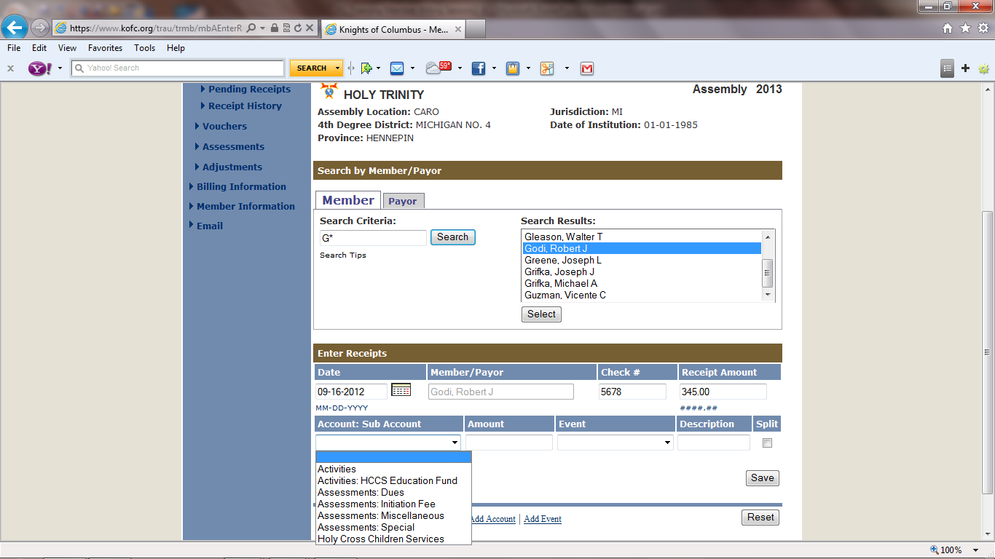
We have filled in the “Check #” & “Receipt Amount”. We have clicked on the down arrow in the “Accounts: Sub Account” box . The drop down menu list our account. We will highlight the “Activities”.

Slide 42
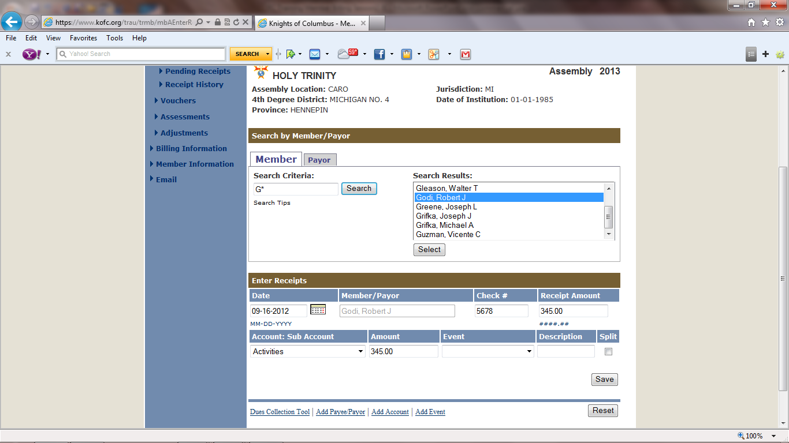
We have selected the “Activities & filled the “Amount” box. We will click on the down arrow in the Events box for our drop down the menu of “Events”.

Slide 43
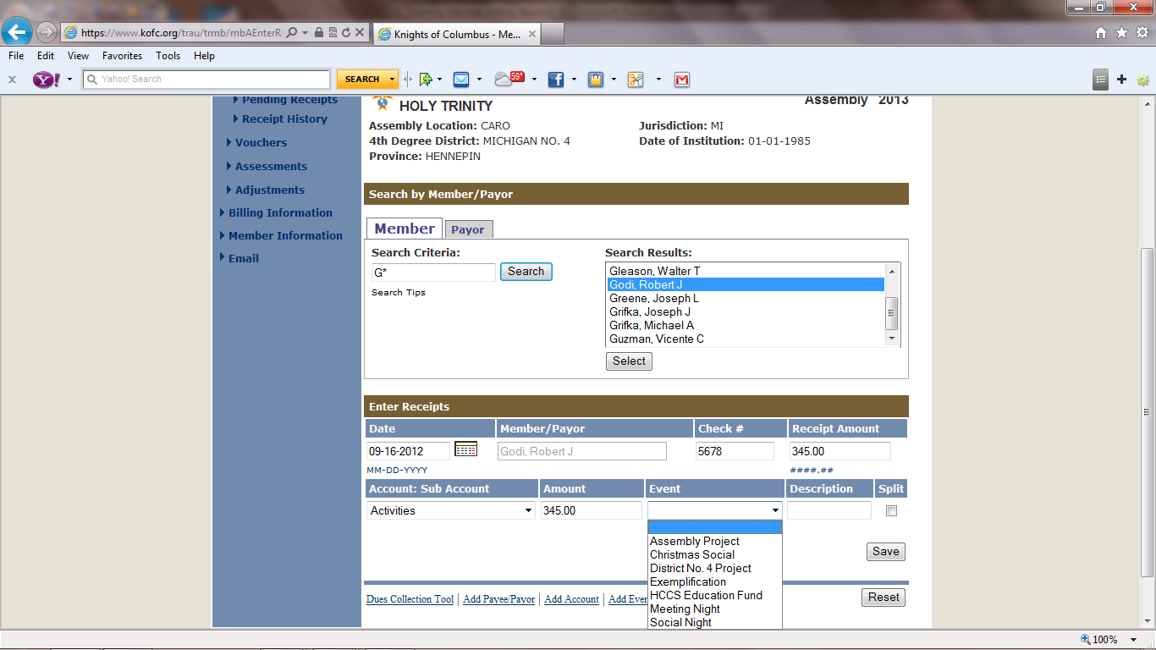
We have selected the “Christmas Social” from the drop down menu. Now we will save this transaction.

Slide 44
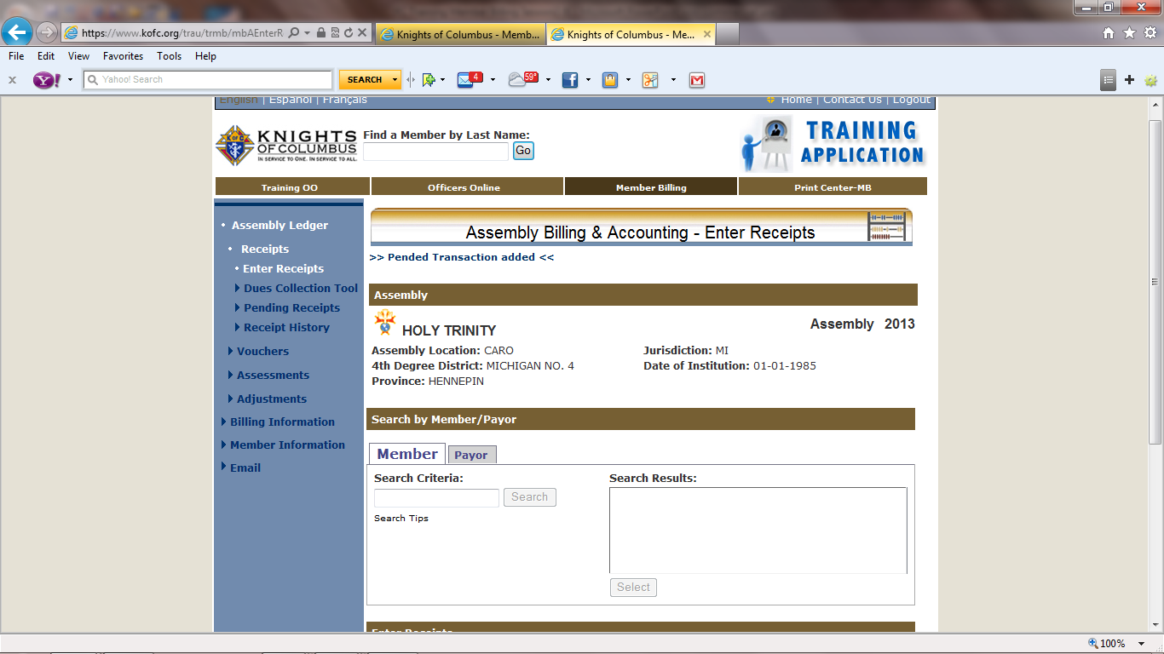

Slide 45
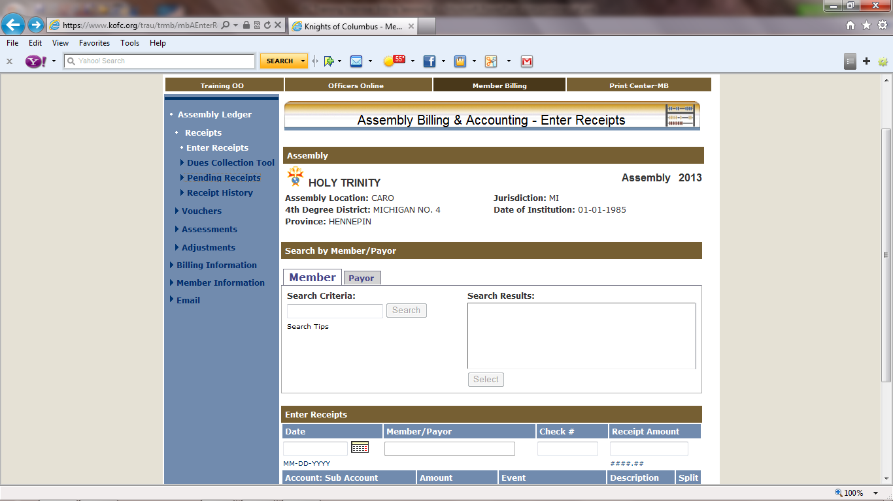
We will now look at our receipts by clicking on the “Pending Receipts” link.

Slide 46
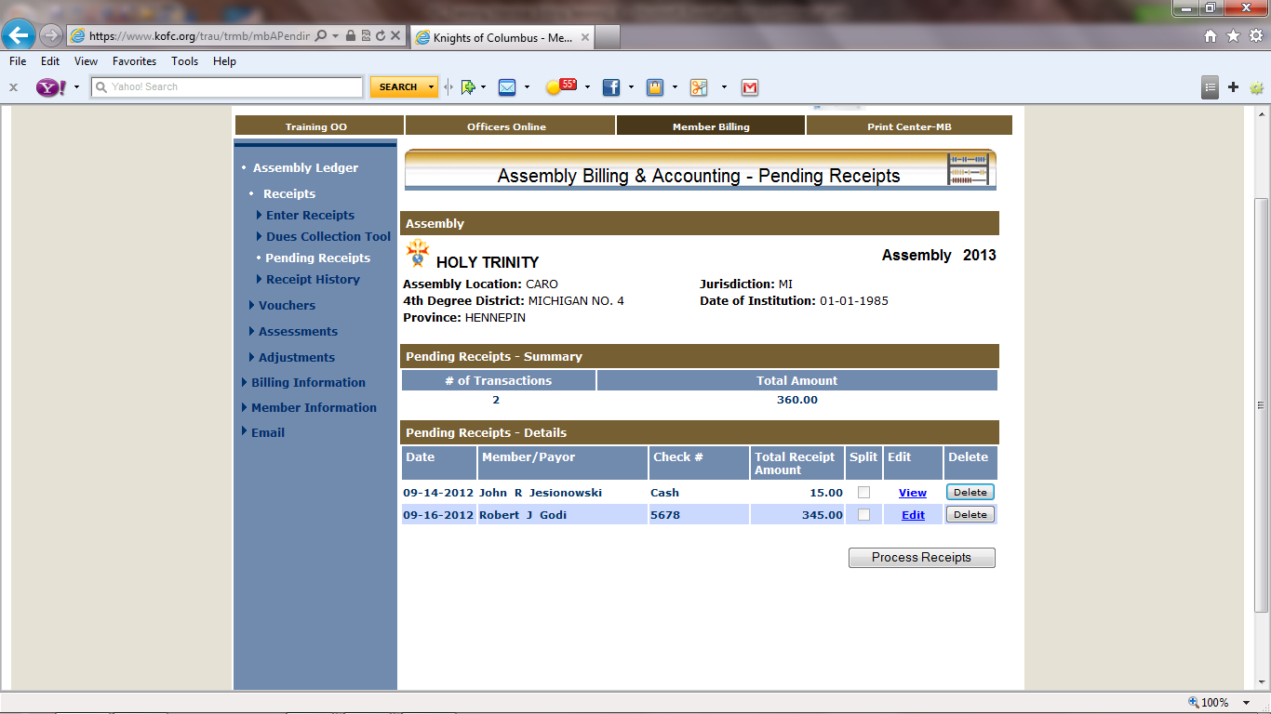
These are the monies we have received. We can “Edit” only the second one. We can only view the other one because it is “Dues”. We can “delete the transaction and Start over before we process it. We will “Process Receipts”.

Slide 47
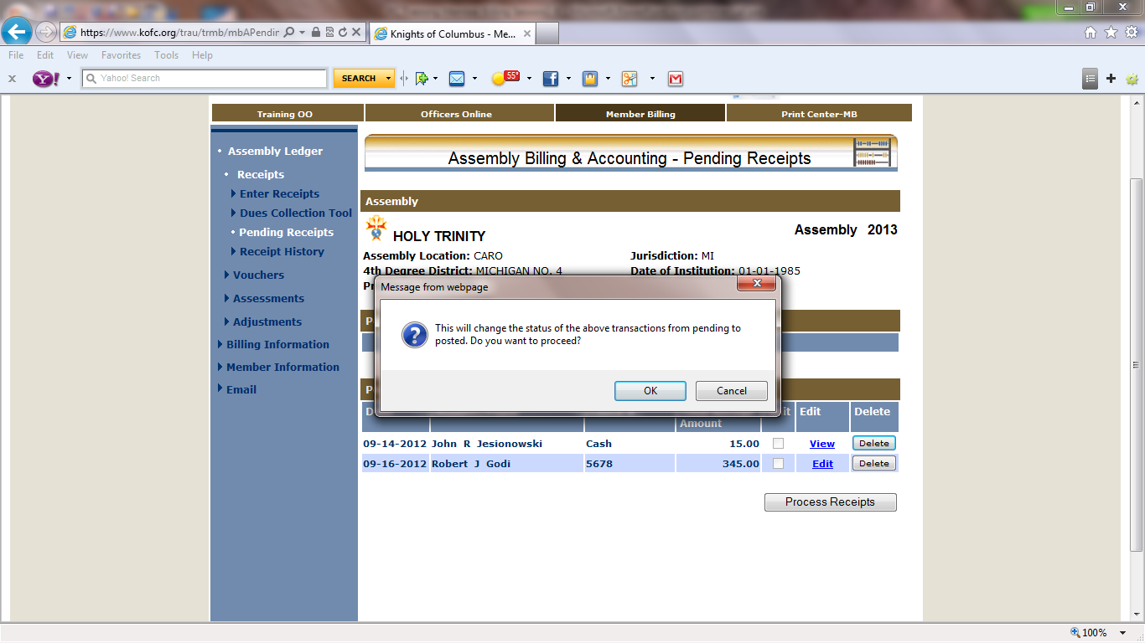
The system will give you the opportunity to go back and check your transactions. If correct click “OK”.

Slide 48
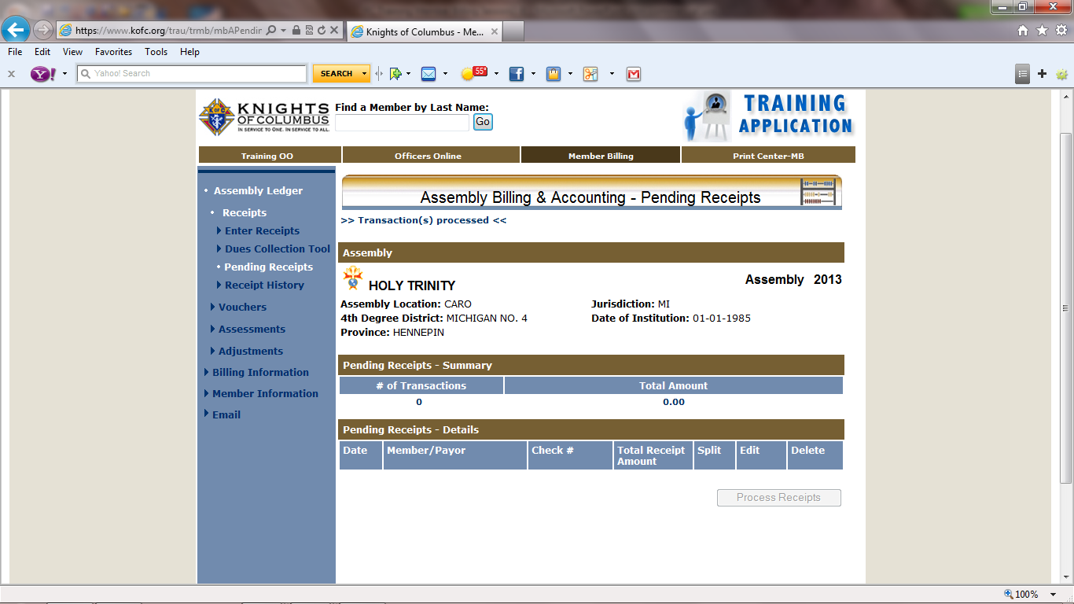
We will now print a report of “Receipts” by clicking on “Print Center–MB” tab

Slide 49
A member giving a larger donation then what was set up in Special Assessment when paying his dues must be recorded through “Enter Receipts”. Additional money will be a credit for next years dues. Therefore extra money must be designated to its proper account.

Slide 50
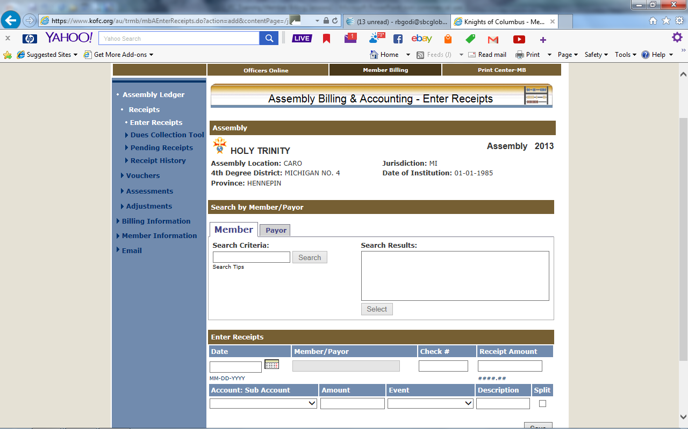
Select “Enter Receipts”

Slide 51
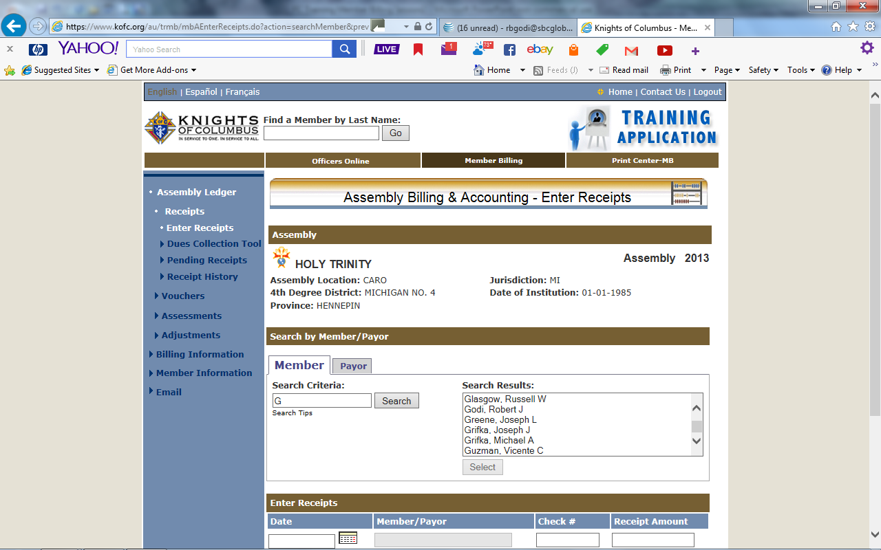
We will choose Godi, Robert J

Slide 52
Sir Knight Godi is an “Honorary Life” member who has a Special Assessment of $5.00. He has sent in $20.00. For the system to process this amount correctly the amount must be entered through “Enter Receipts”. The following slides will demonstrate ---

Slide 53
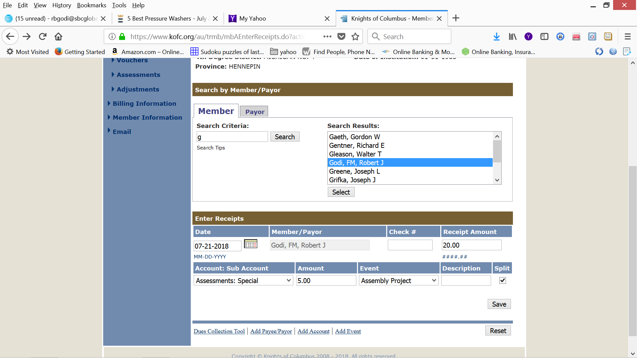
Enter check number and amount of check. Fill in Sub Account, the assessed amount (5.00) and Event. Check “Split”.

Slide 54
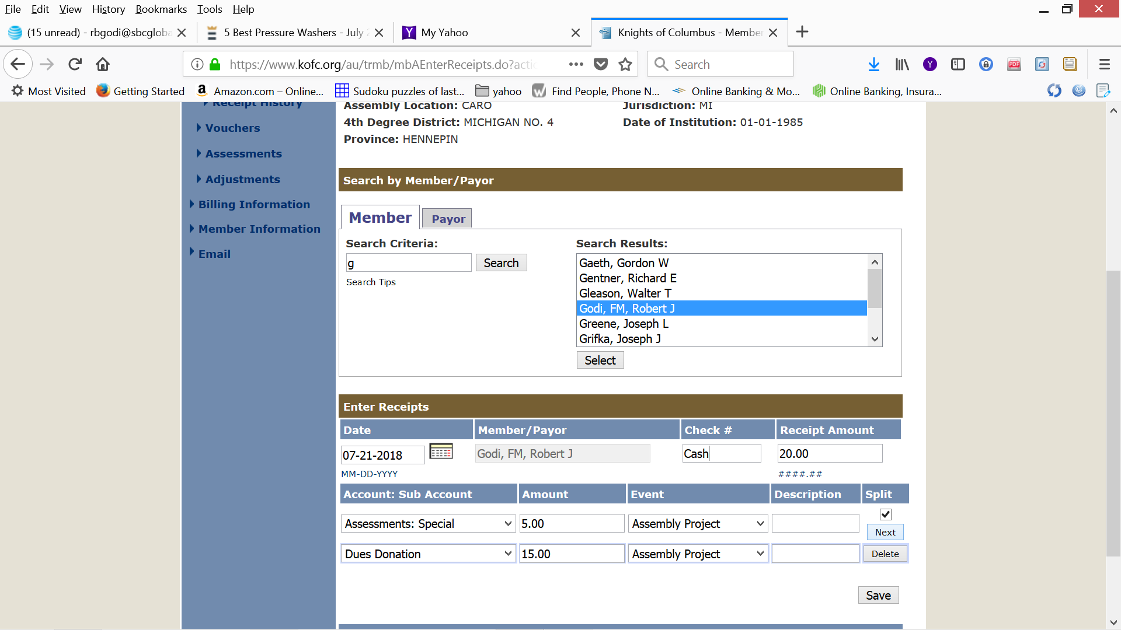
When the screen refreshes it will give you a second line to enter Sub Account, Amount (15.00) and Event. When the amounts equal the Receipt Amount (20.00) click on save.

Slide 55
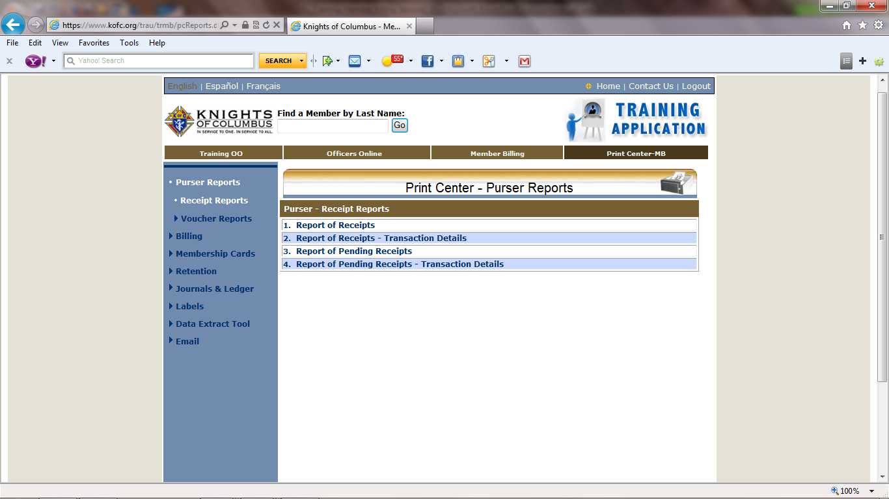
We have opened the “Print Center-MB”. We will now click on “Report of Receipts”

Slide 56
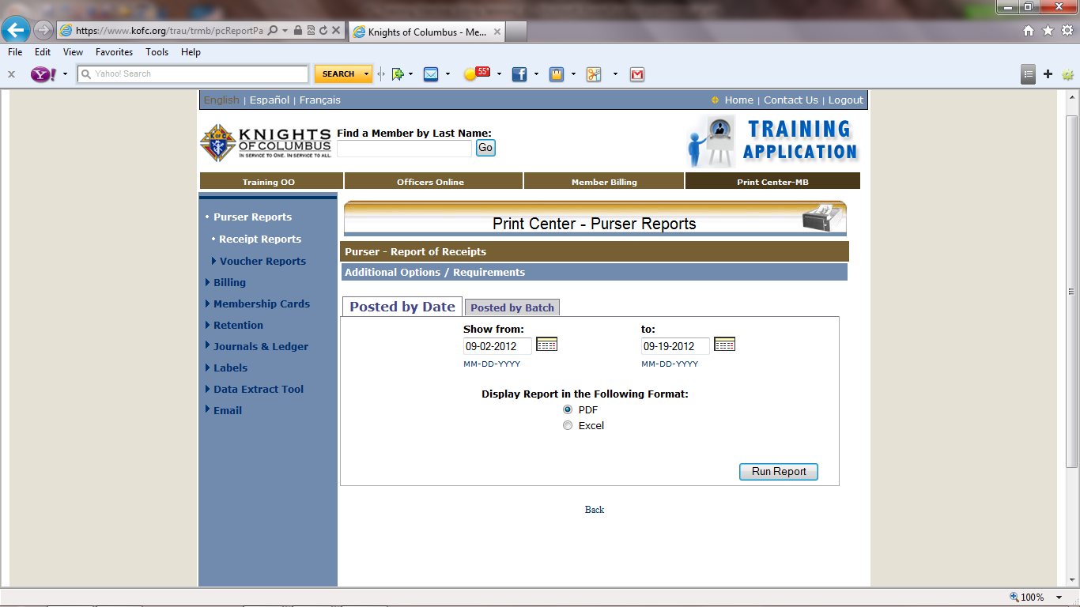
We are using the “Posted by Date” tab. We will fill in the “Show from:” & “to:” date to cover the dates of our transaction then click on “Run Report” link.

Slide 57
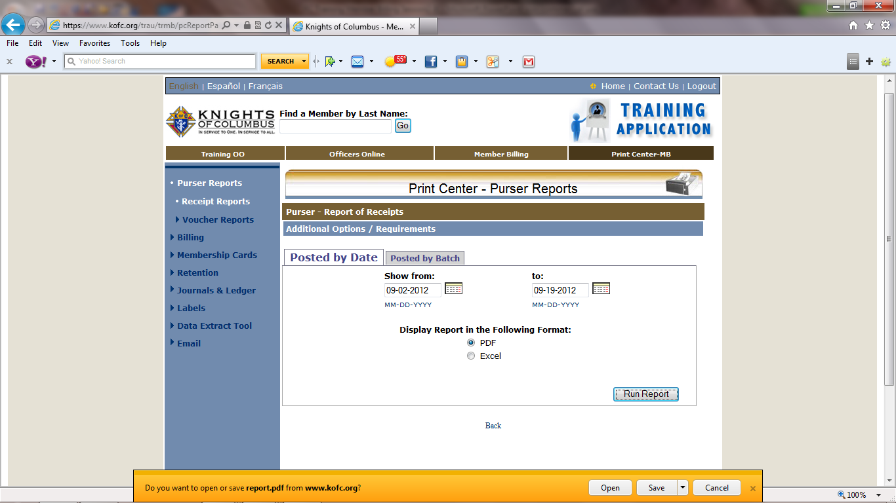
You will be asked if you want to “open” or “Save” I prefer to “open” then save later to assembly receipts file folder.

Slide 58
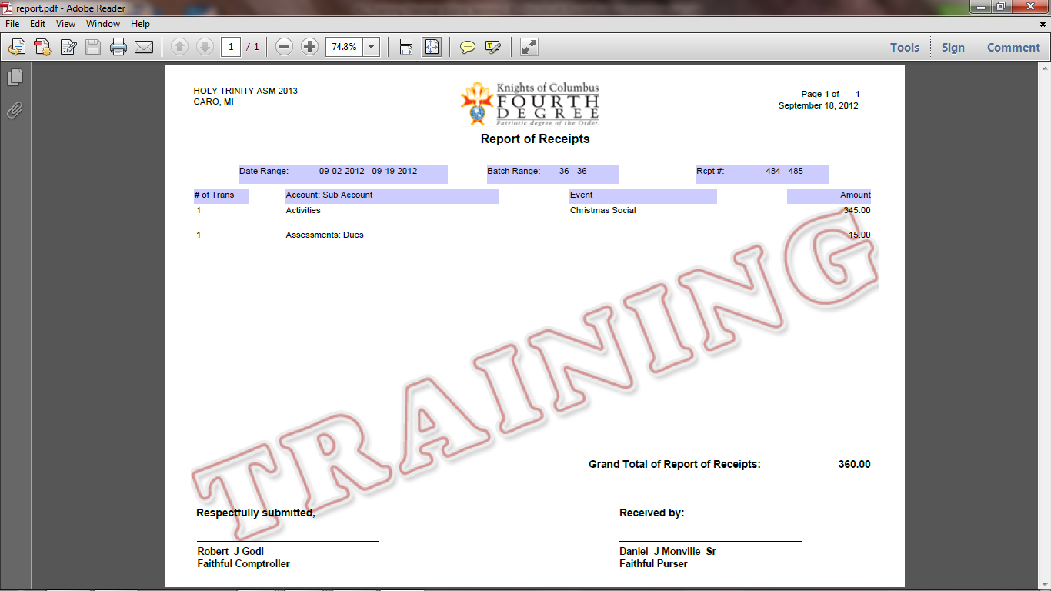
This is a PDF format. Print 2 copies. Sign both and give to Purser. He signs and returns one copy to the F.C,
Note: This was generated in the Training Data Base

Slide 59
We will now write vouchers for a “Member” and a “Payee”. We will begin with member voucher first. “Member” tab is LARGER.

Slide 60
We are writing a Voucher for Harold Avery. We have filled in the “Search Criteria:” The same as we did in MM. We will now select by high-lighting Avery and Press “Select Button

Slide 61
After we select Sir Knight Avery the screen refreshes with the Date & Member Name filled in. We fill in the amount, Account: Sub Account, the Amount, and Event. Then Save.

Slide 62
We are writing a Voucher to Supreme. We have filled in the “Search Criteria:” with S*. We will now select by highlighting Supreme Council and Press “Select” Button

Slide 63
After we select K of C Supreme Council the screen refreshes with the Date & Payee Name filled in. We fill in the amount, Account: Sub Account , the Amount. Then Save

Slide 64
We have opened the “Pending Vouchers” Tab
We will now process the vouchers by clicking

Slide 65
Click “OK”

Slide 66
NOTE

Slide 67
We will click on “Print Center-MM and select “Report of Vouchers”

Slide 68
Fill in the Date boxes and click on “Run Report”

Slide 69
You can save or open. I prefer to open then save to assembly voucher file folder later. The program will generate a Document in PDF Format.

Slide 70
You can save the document to your computer by File tab. You will need to print 2 copies of this document. Sign, give to Faithful Navigator to Sign, then give both copies to the Purser to Sign. He will keep one copy for his records and return one copy to you for the assembly record.

Slide 71
This has been an overview of Assembly Accounting
Session three will be on
Member Billing

